Slide 1
BCX19 Social Impact Hack
Mitigation of Post-Harvest Loss
Fabian Hovestädt
Tilman Linden
Marius Luft
Mohamed Megahed
Rodrigo Piña
Grain Supply Chain
Use Case by UN World Food Programme

Slide 2

A Multifold Problem
The whole process needs to be redesigned On a long term to deliver better results over time..
Short-sighted decision-making Farmers need to be paid immediately
Decentralized Value Chain Nonexistence of bigger companies to take care of the process
Trust Issues go over Quality But no-one buys the “cat in a bag”, but a quality check results in damaging the crop
Notes:
Problem statement
We can make a good design, but reality looks different
We are dealing with a fragile value chain. Any minimal change causes a big difference. cannot predict harvest of next year and has to make short-term decisions
No supplier takes care of the process to ensure quality. No supervision, only instantaneous checks
Bags need to remain airtight throughout, but also need to be opened.
This all results into giving a primitive business model

Slide 3
Aim
Minimally invasive technology to
Increase Farmers’, Traders’ and Wholesale’s profit margin Once bags can stored for longer
Leverage value chain through trust With help of blockchain and smart contracts
Save agricultural waste More quality food with scalable returns
Notes:
Indicator if Bag needs to dry
Save agricultural waste → More (quality) food to the world

Slide 4
Propositions: A holistic solution
(With a little help from a few smartphones)
Sensor Data (Humidy)
RFID
smartphones
Notes:
It’s not as simple as just redesigning the bags.
We don’t know how this architecture will prove itself useful
Capacitive

Slide 5
Bag Design
Zipper system
Repackaging
Durability
Traceability
Quality Control
Notes:
If two bags then +, otherwise one vertical zip
Balluff

Slide 6
Sensors
Can sense humidity → fermentation
Preventative Alert against spoilage
Capacitor
RFID + Farmer ID

Slide 7
Mobile / Web app
Smart contracts (Blockchain)
Display sensor data
Trace bonus prospects (Farmers)

Slide 8


The Google Translate app can repeat anything you say in up to NINETY LANGUAGES from German and Japanese to Czech and Zulu
Tip
Don’t wait till the end of the presentation to give the bottom line.
Reveal your product or idea (in this case a translation app) up front.

Slide 9
2. Examples
By the end of this section, your audience should be able to visualize:
What What is the pain you cure with your solution?
Who Show them a specific person who would benefit from your solution.

Slide 10
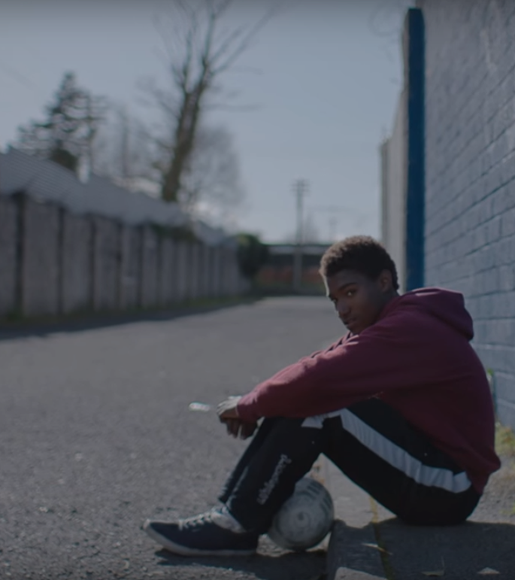
Meet Alberto.
He recently moved from Spain to a small town in Northern Ireland.
He loved soccer, but feared he had no way to talk to a coach or teammates.
Tip
Tell the audience about the problem through a story, ideally a person.

Slide 11

Meet Marcos.
He recently opened a camera shop near the Louvre in Paris.
Visitors to his store, mostly tourists, speak many different languages making anything beyond a simple transaction a challenge.
Tip
If one example isn’t sufficient to help people understand the breadth of your idea, pick a couple of examples.
Story for illustration purposes only

Slide 12
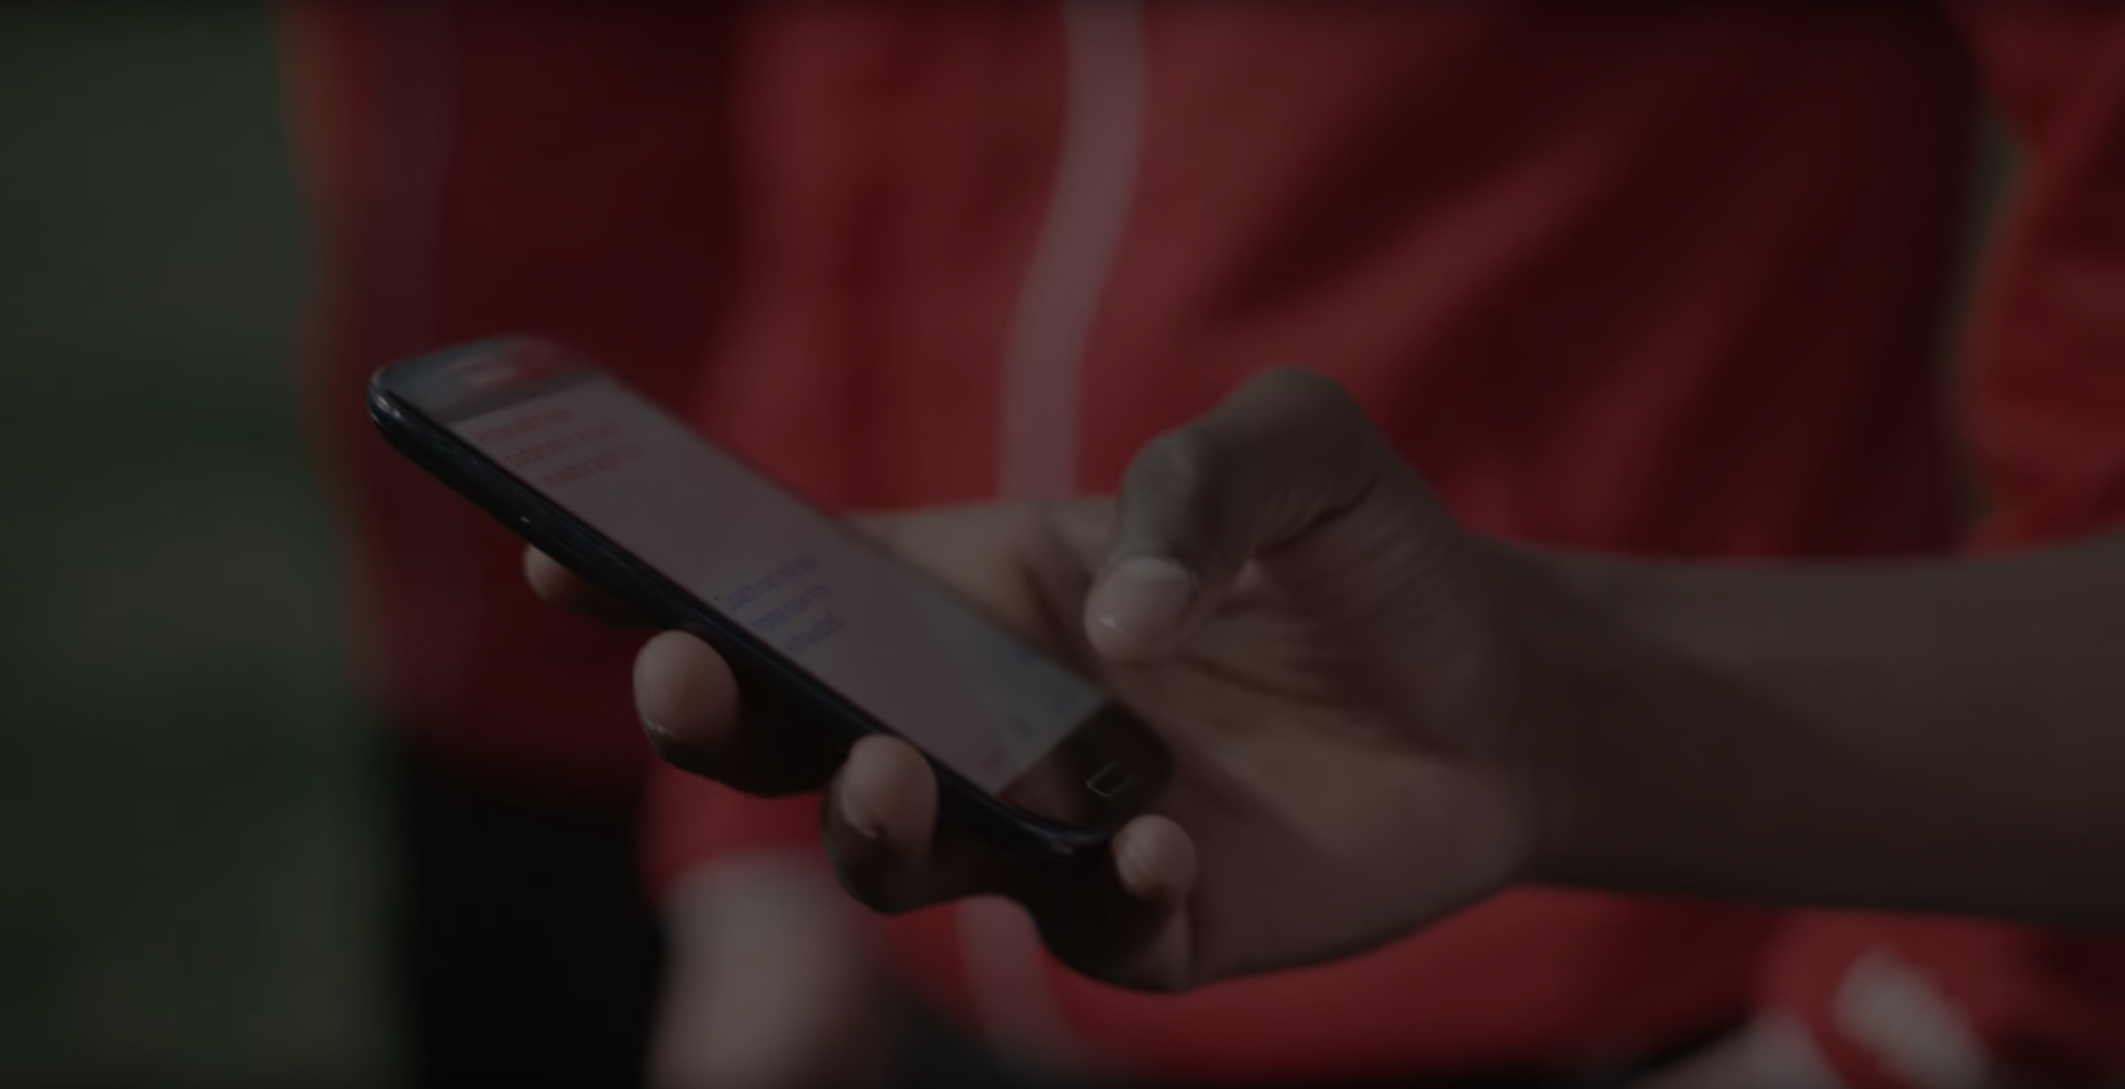
A translation barrier left Alberto feeling lonely and hurt Marco’s business.
Tip
Ideally, speak of people in very different situations, but where each could benefit from your solution.

Slide 13
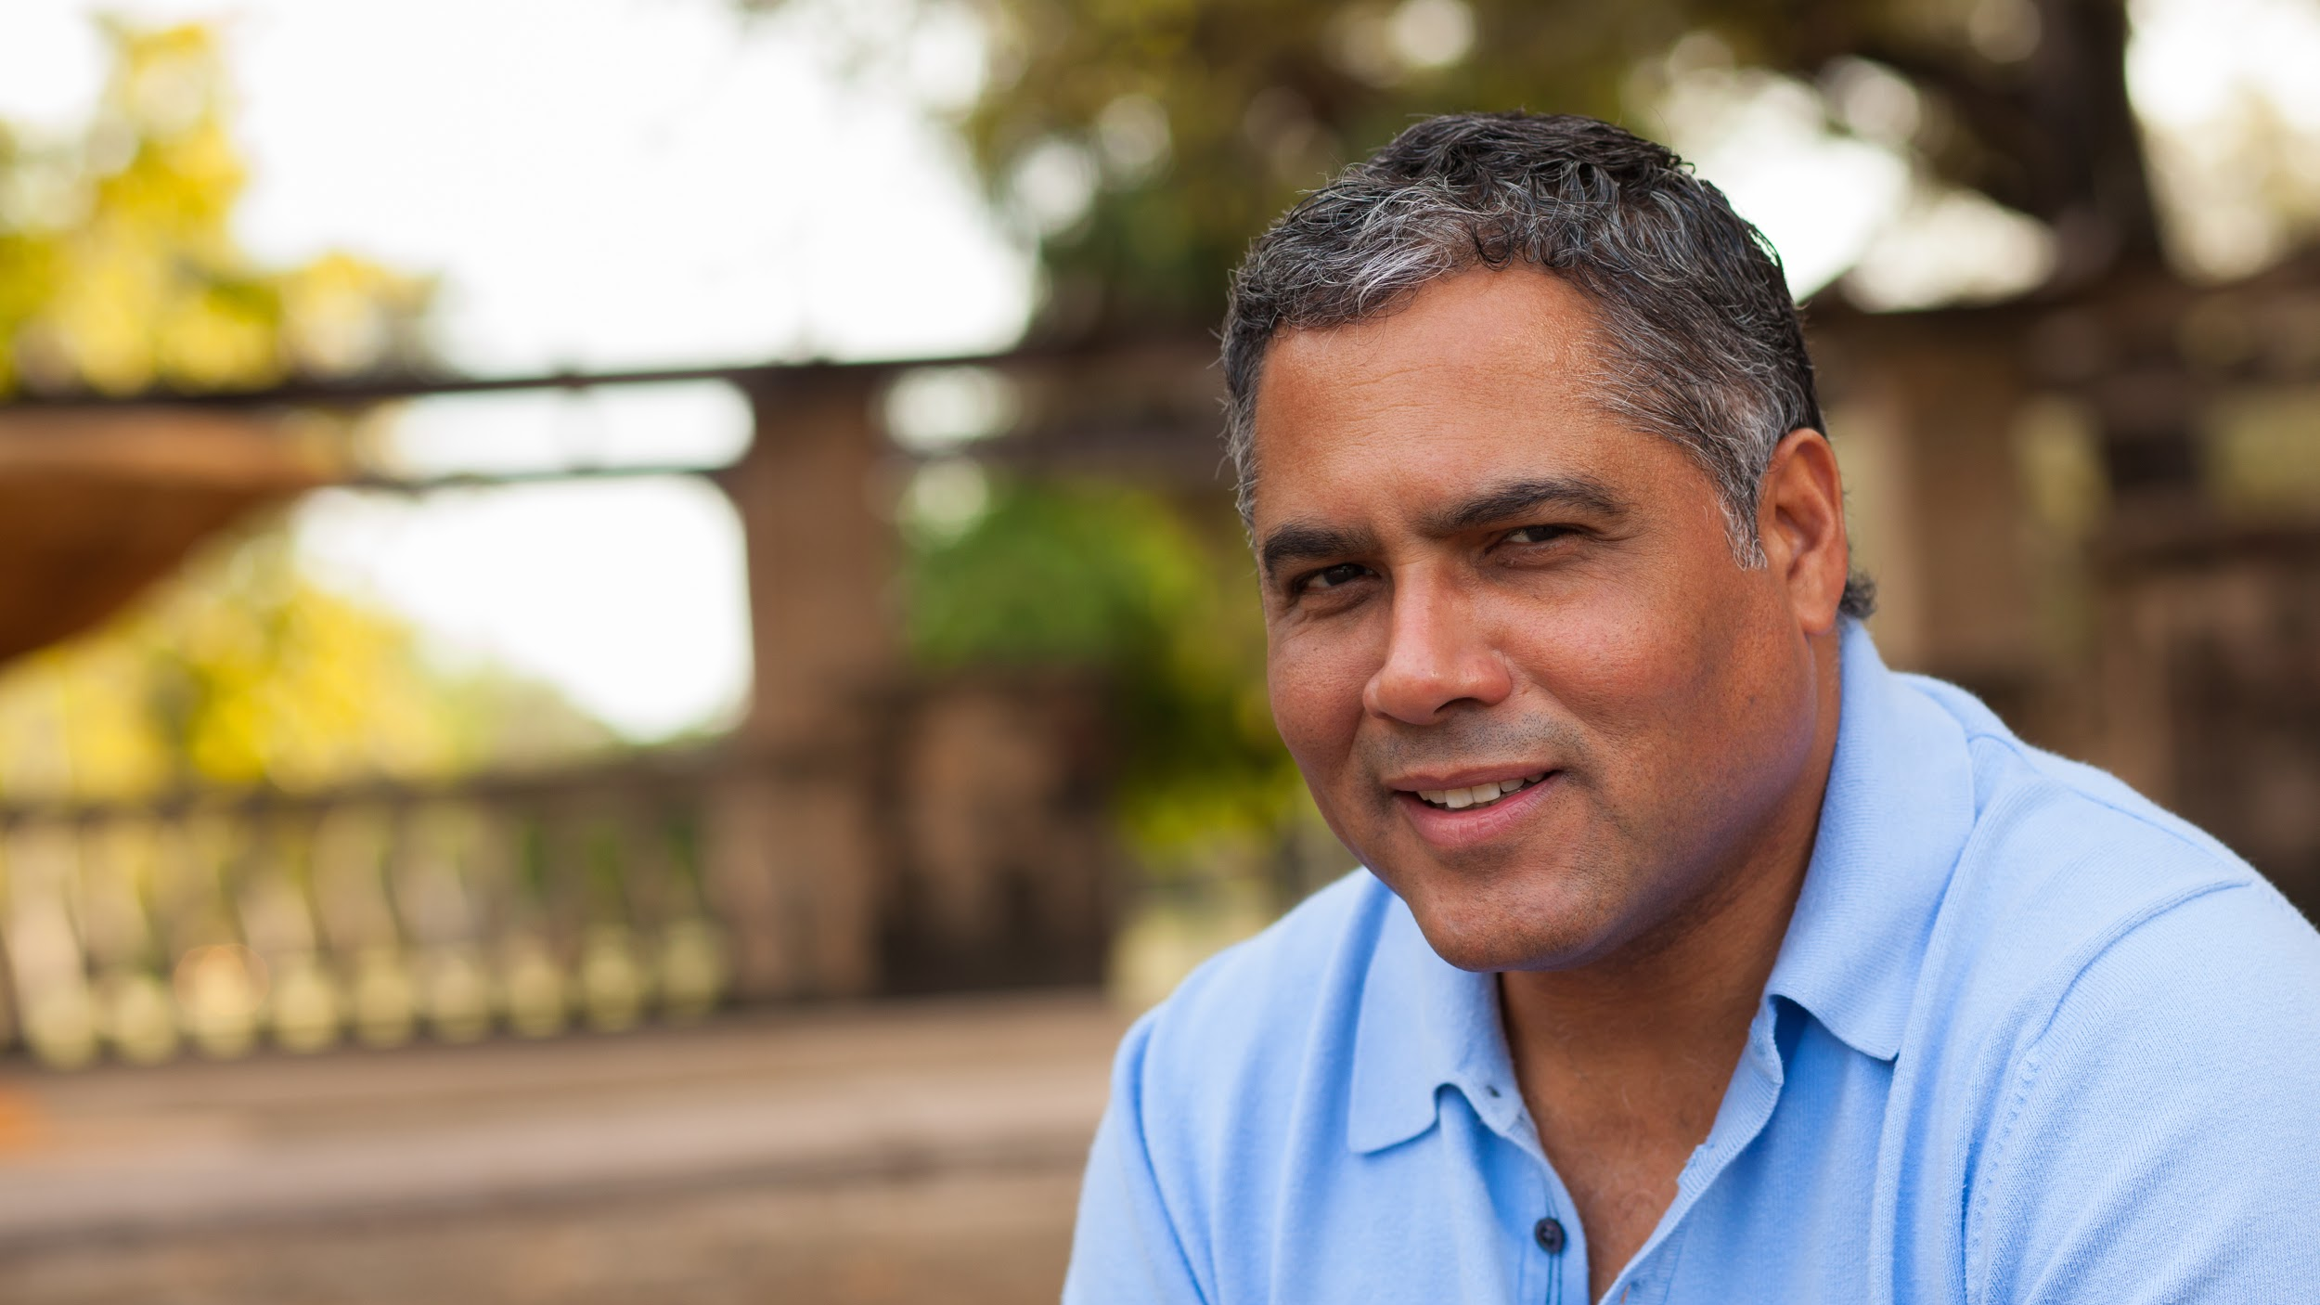
Then, Marcos discovered Google Translate
He has his visiting customers speak their camera issues into the app.
He’s able to give them a friendly, personalized experience by understanding exactly what they need.

Slide 14
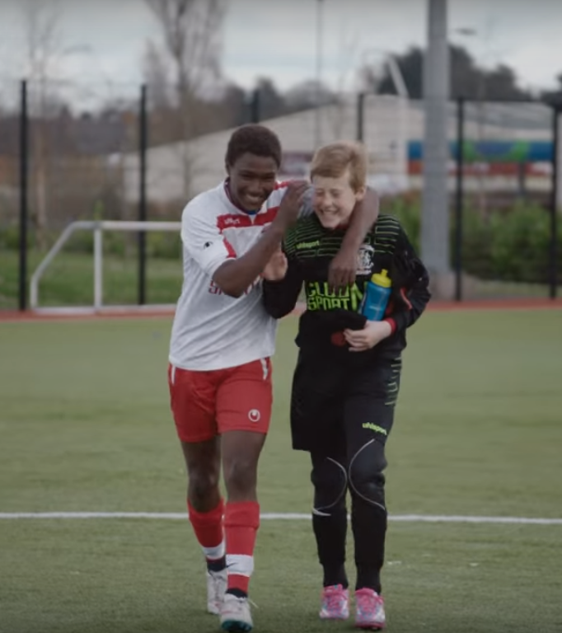
A simple gesture
Coaches Gary and Glen knew no Spanish.
They used Google Translate to invite Alberto to join in... “Do you want to play?”... “Can you defend the left side?”
Tip
Show how your solution helps the person in the story reach his or her goals.

Slide 15

From outsider to star
Alberto scored 30 goals in 21 games. He is now being scouted by several professional clubs in the Premier League. And he’s a favorite of the other boys on the team.
See a short video on Alberto’s story
Tip
Stories become more credible when they use concrete details such as the specific complex moves Alberto learned through Translate and his 30 goals in 21 games performance stats.

Slide 16
3. Examples
People need to understand how rare or frequent your examples are.
Pick 1 or 2 statistics and make them as concrete as possible. Stats are generally not sticky, but here are a few tactics:
Relate Deliver data within the context of a story you’ve already told
Compare Make big numbers digestible by putting them in the context of something familiar

Slide 17
It’s no surprise Marcos uses Google Translate in his shop regularly.
There are 23 officially recognized languages in the EU.
Tip
Don’t let data stand alone. Always relate it back to a story you’ve already told, in this case, Marco’s shop.
Source: theguardian.com

Slide 18


More than 50 million Americans travelled abroad in 2015
THAT’S MORE THAN THE POPULATION OF
CALIFORNIA AND TEXAS COMBINED
Tip
When a number is too large or too small to easily comprehend, clarify it with a comparison to something familiar.
Source: travel.trade.gov

Slide 19
4. Closing
Build confidence around your product or idea by including at least one of the these slides:
Milestones What has been accomplished and what might be left to tackle?
Testimonials Who supports your idea (or doesn’t)?
What’s next? How can the audience get involved or find out more?

Slide 20
Milestones
October 2014
October 2015
August 2015
November 2015
Translate web pages with Chrome extension
Translate text within an app
2014 |  |  |  | 2015
Translate conversations through your Android watch
Translate written text from English or German to Arabic with the click of a camera

Slide 21
What people are saying
With this app, I’m confident to plan a trip to rural Vietnam
Wendy Writer, CA
Visual translation feels like magic
Ronny Reader, NYC
Translate has officially inspired me to learn French
Abby Author, NYC
Quotes for illustration purposes only

Slide 22

Know a 2nd language? Make Google Translate even better by joining the community.
Tip
Inspire your audience to act on the information they just learned.
Depending on your idea, this can be anything from downloading an app to joining an organization.

Slide 23

Good luck!
We hope you’ll use these tips to go out and deliver a memorable pitch for your product or service!
For more (free) presentation tips relevant to other types of messages, go to heathbrothers.com/presentations
For more about making your ideas stick with others, check out our book!

